Slide 1
Exercise 11: Changing Canons of Beauty

Slide 2
Let’s start with an example of the definition of beauty a few centuries ago….

Slide 3

The Venus of Willendorf
What was considered beautiful in the past has really changed in recent years. First off, having an ideal or “perfect body” is a modern conception. This was different a few centuries ago!

Slide 4
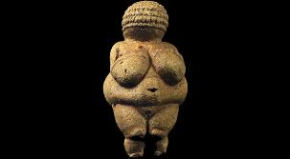
This is a primitive sculpture idealizing the beauty of a female body more than 20,000 years ago. According to an essay by Bryan Zygmont, the sculpture idealized the paradigm of fertility. In other words, everyone was beautiful regardless of the features that define a beautiful body.
The sculpture doesn’t look at all like the models of today! Isn't?
The Venus of Willendorf
Notes:
Reference
Zygmont., B. (n.d). The Venus of Willendorf: Essay. Retrieved from <https://www.khanacademy.org/humanities/prehistoric-art/paleolithic-art/a/venus-of-willendorf>

Slide 5
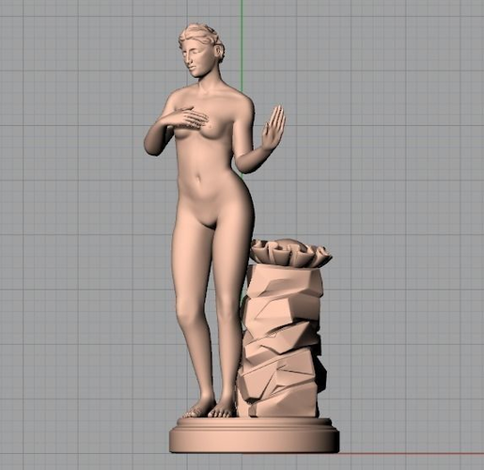
Today, a beautiful body goes beyond being curvy!
Features: full breasts, large curvy hips, and a flat tummy.

Slide 6
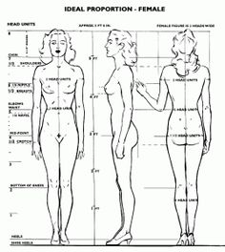
What is considered a beautiful body today, may not have been in ancient times.
In ancient times, Plato endorsed the Greek-born “golden ratio” as the bar by which all beauty was subconsciously judged.

Slide 7
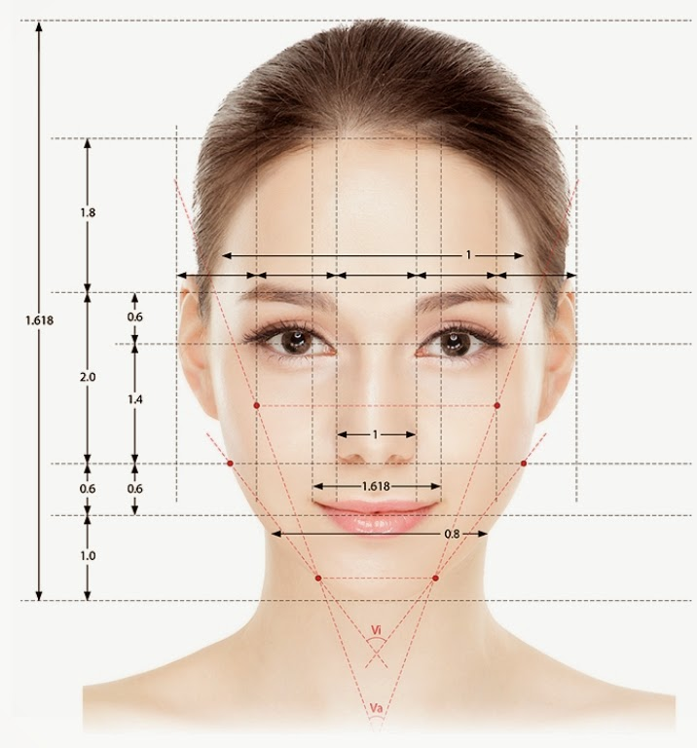

Plato believed that beauty was a mix of symmetry and harmony, which led him to develop the golden proportion for faces.
An article in Evoscience, explains the theory in which, “the ideal face width was considered should represent two-thirds of its length and the face must be perfectly symmetrical.
Is this how we determine whether someone is beautiful today?
Symmetry!

Slide 8
The big assumption of modern beauty is fashion!

Slide 9
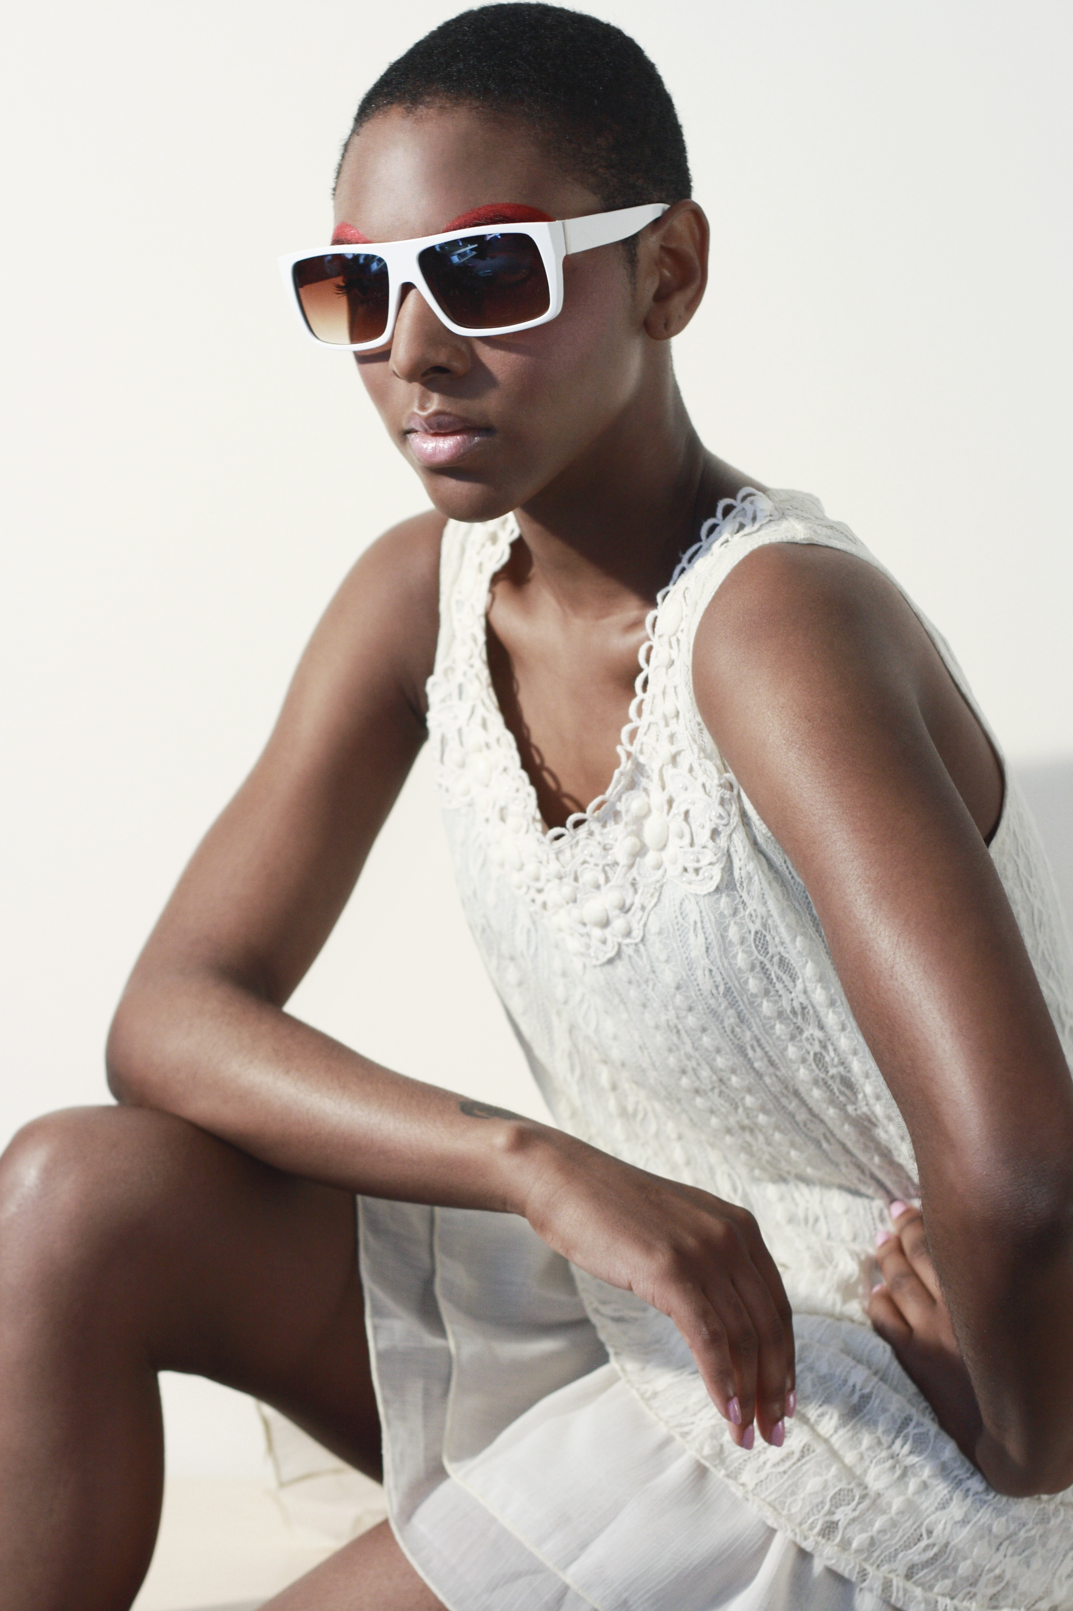
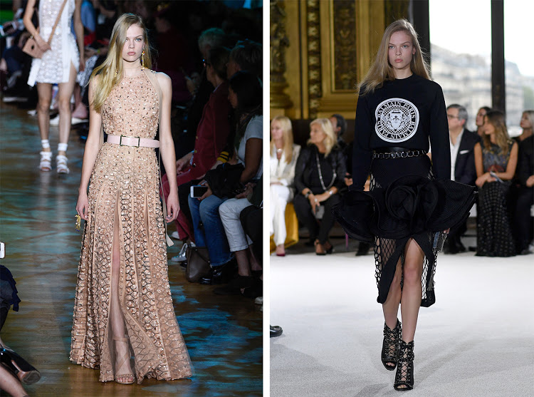
In Modern Societies beauty is all about fashion.

Slide 10
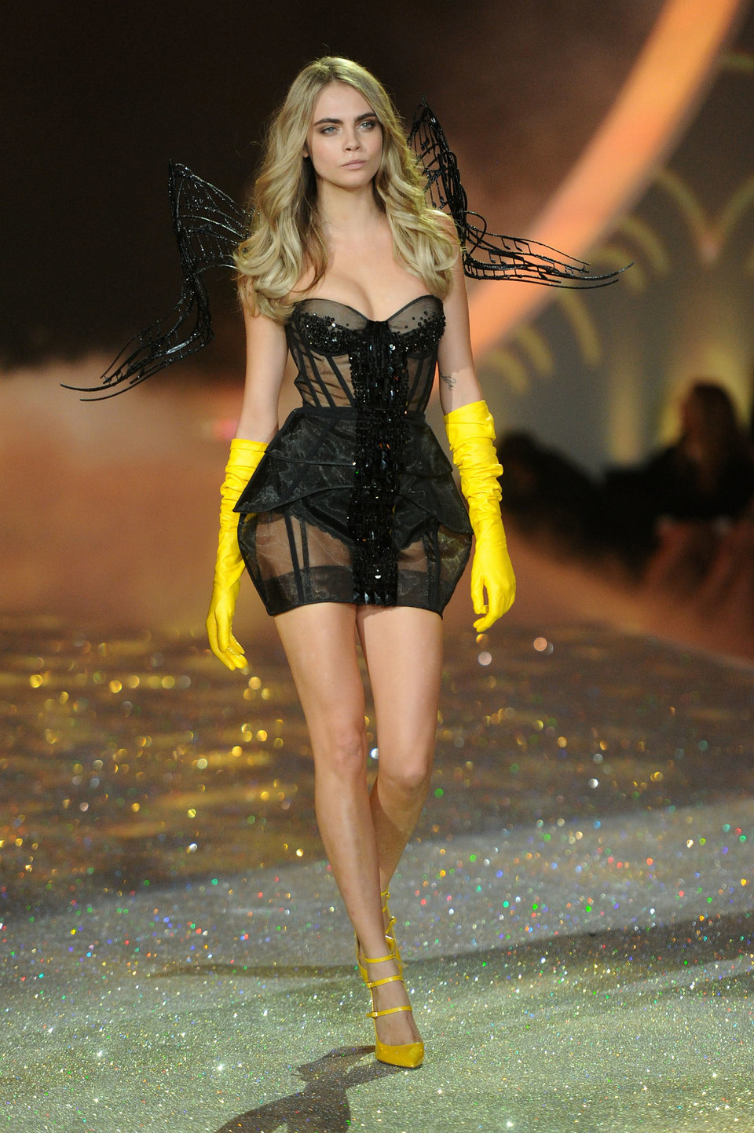
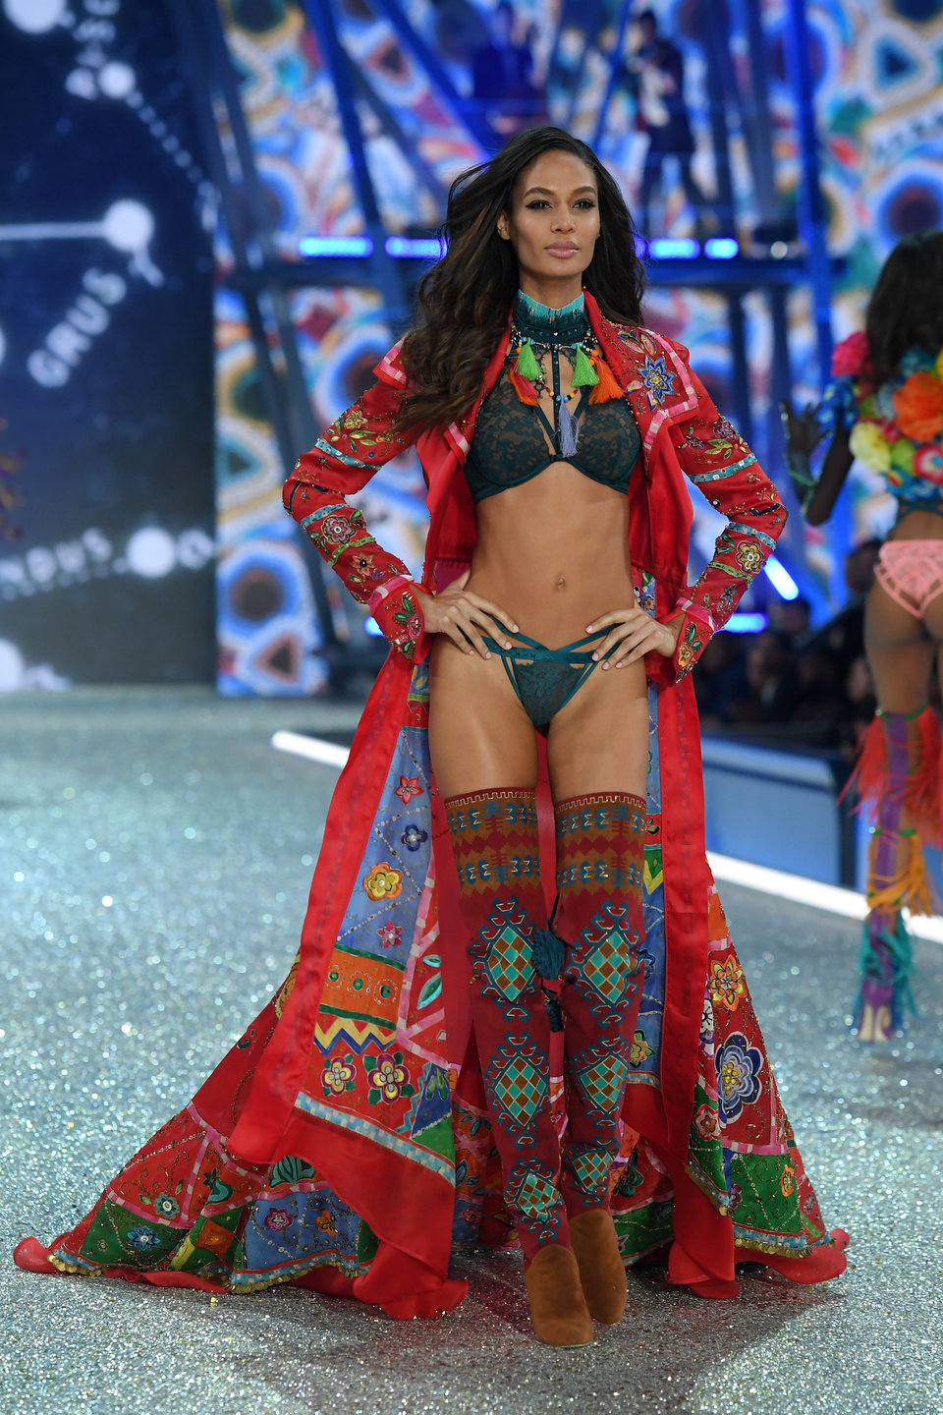
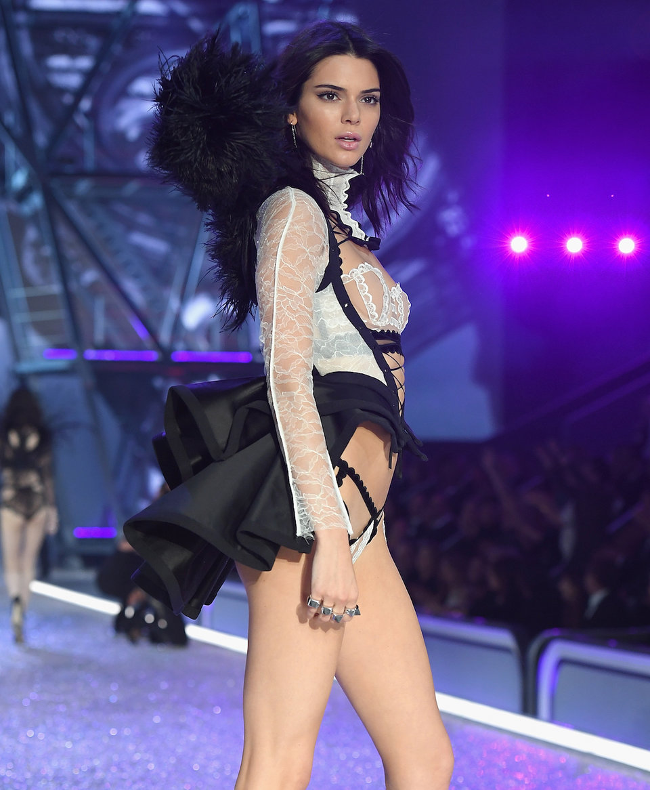
A British Model
A Latin Model
An African Model
An American Model

Slide 11
Features of idealized beautiful women in the modern world:
Fashion and style, features considered as the defining factors of beautiful in the past are no longer features of a beautiful body in the modern body. Almost all cultures are now amplifying fashion and style.
The trending essence of makeup routine is quickly taking over the place of natural beauty.
Fashion and Style is what makes me beautiful!

Slide 12
Features of idealized handsome men in the modern world:
The same thing applies to men!
Fashion and style: features considered as the defining factors of a handsome body are no longer features considered . Almost all cultures are now amplifying fashion and style in men.
A strong masculine body is losing importance in the modern world. Men are also doing make ups and applying beauty products on their bodies. In the past, male handsomeness was measured by the ability of strength!

Slide 13
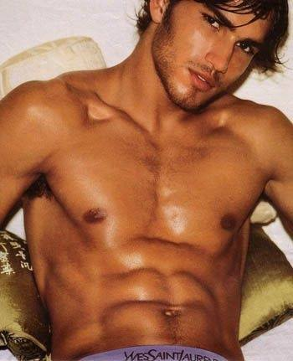
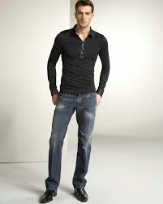
What defines male handsomeness?
Fashion and Style
It is a trend in all Modern Cultures!

Slide 14
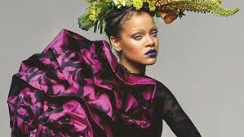
Natural Looks
What we recently see on Vogue is that beauty is no longer defined by natural looks. Besides wearing fashion clothes and ornaments, models are wearing makeups to define their beauty.

Slide 15

How are males improving their handsomeness?
A strong body is almost out of the equation.
They want to be smart!

Slide 16
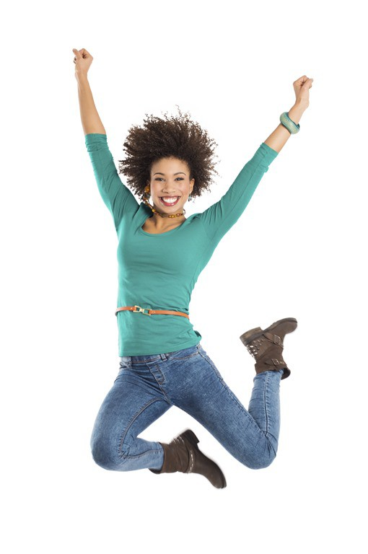
The standard of beauty for females has changed:
Girls want to look thin, curvy (hourglass shaped) and with long beautiful hair, nails and so forth.
They are now wearing short skirts whose hemline are above knee high in order to show their beautiful legs.

Slide 17
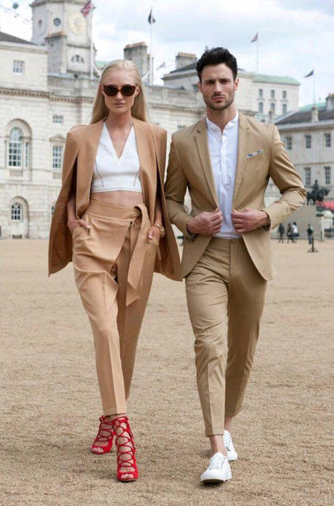
Conclusion
A symmetrical body is no longer a determinant of a beautiful body for females neither a strong body for males!
Fashion and Style is the modern determining factor of beauty!

